Slide 1
4-A:-For a given set of training data examples stored in a CSV file, implement least square regression algorithm.

Slide 2
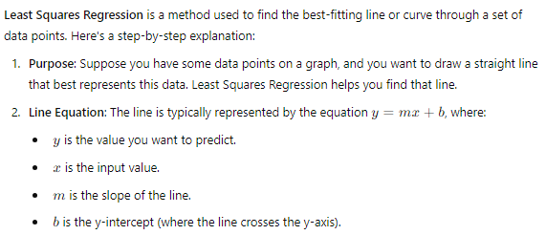
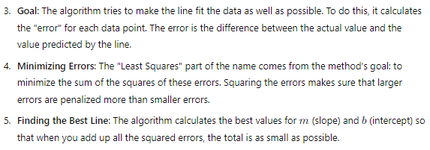

Slide 3
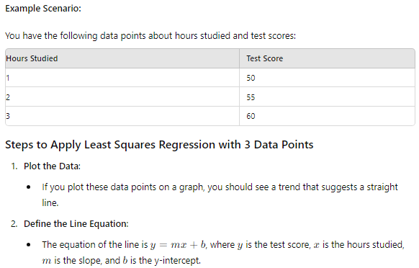
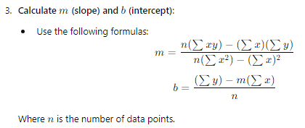

Slide 4
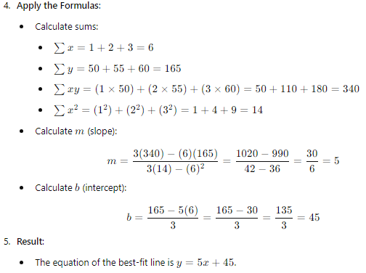
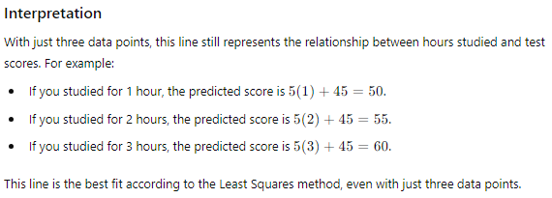

Slide 5
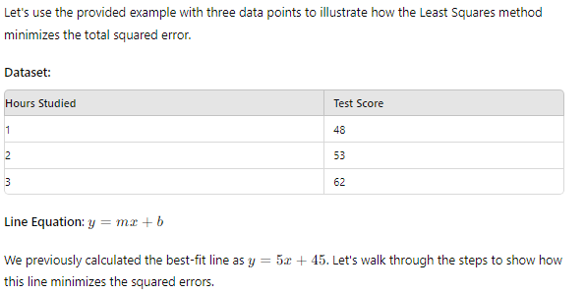
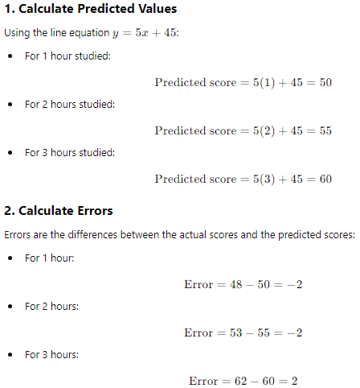

Slide 6
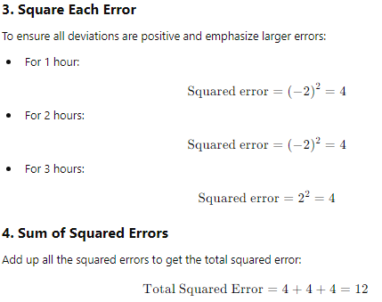
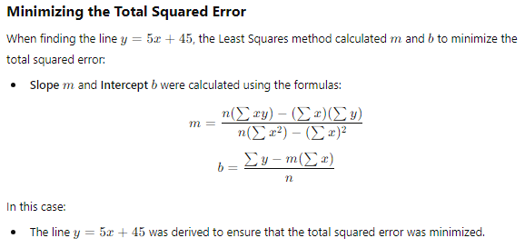

Slide 7

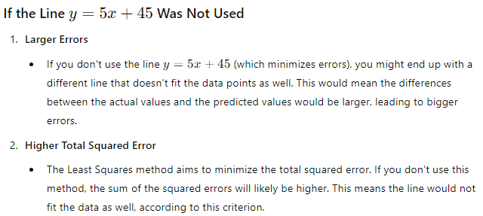

Slide 8
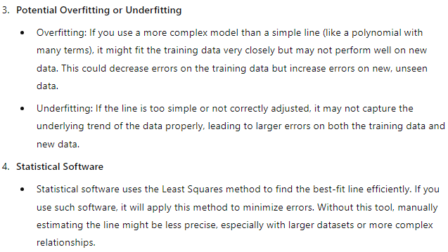

Slide 9
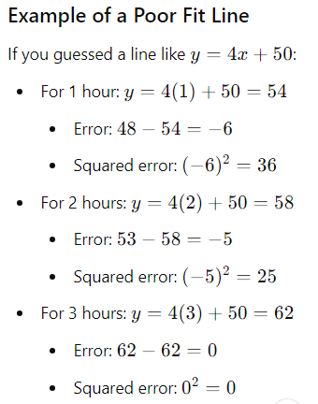

In this case, the total squared error (61) is higher compared to the least squares line’s total squared error (12). This shows how guessing or using a non-optimal line results in less accurate predictions.

Slide 10
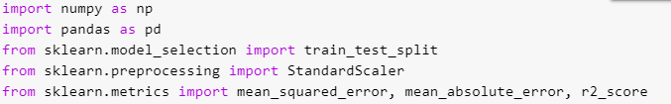



Now, coming to the practical:-

Slide 11


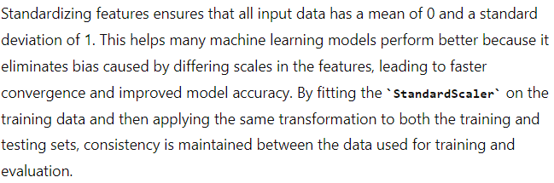

Slide 12

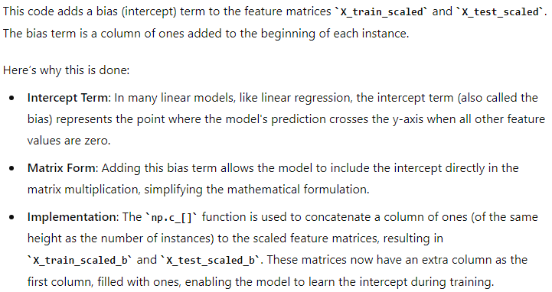
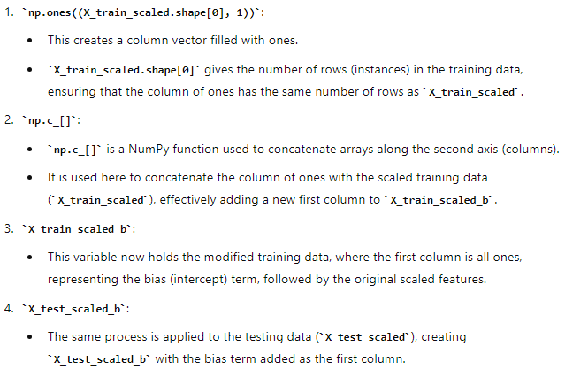

Slide 13
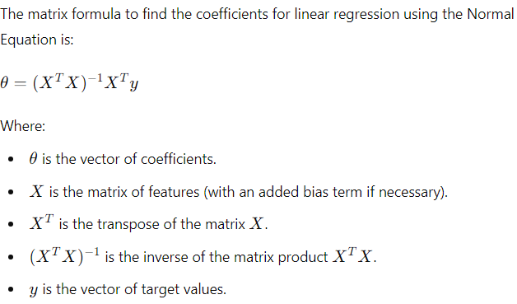
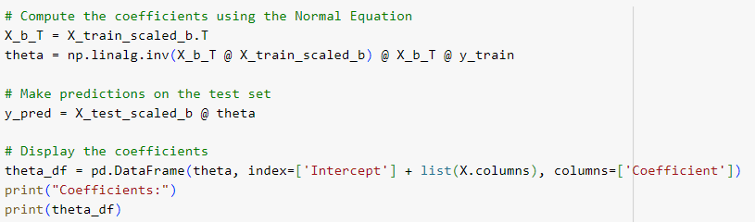
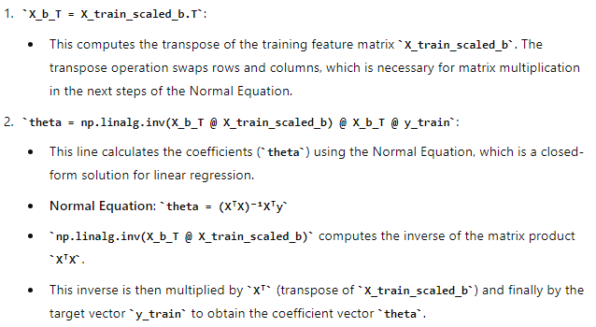
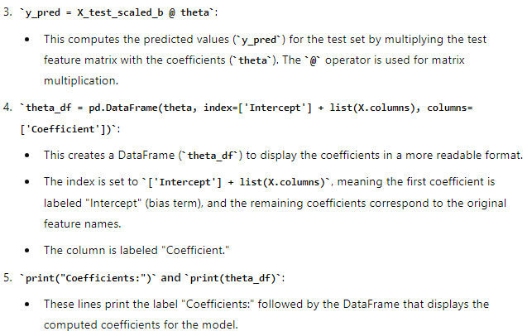

Slide 14
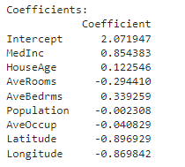



Slide 15
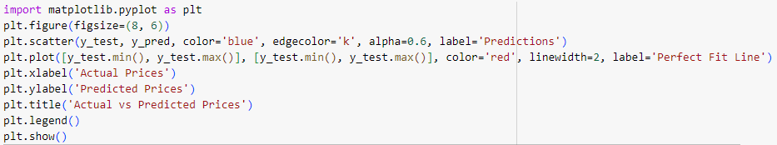
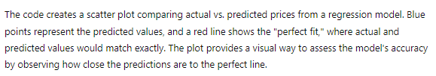
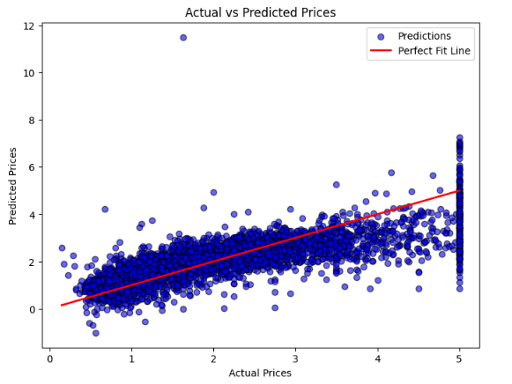
The red line represents the perfect fitting line.

Slide 16
4-B:- For a given set of training data examples stored in a .csv file, implement logistic regression algorithm.

Slide 17
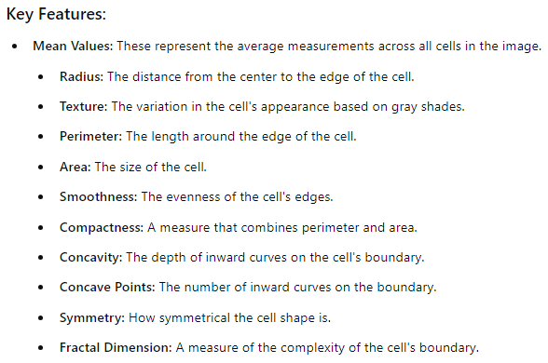
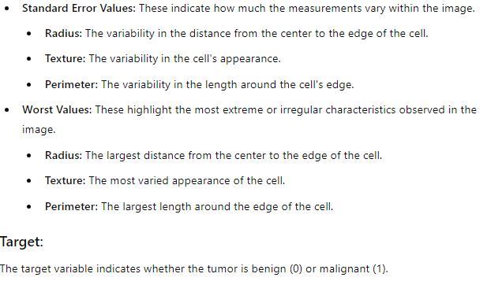
Dataset:-
The dataset consists of various features that describe the characteristics of cell nuclei in breast tumor samples. Each feature helps in identifying whether a tumor is benign (non-cancerous) or malignant (cancerous).

Slide 18
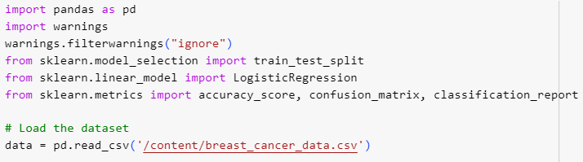
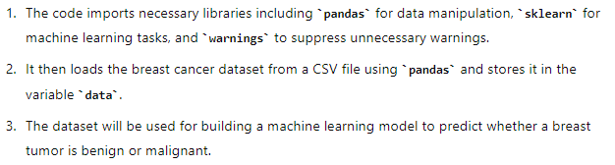
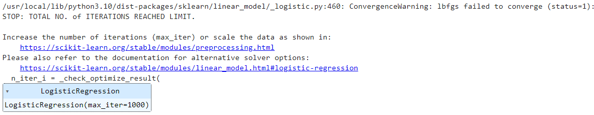

Without Warning:
With Warning:
To handle the ConvergenceWarning or any other type of warning and keep your output clean, it's a good practice to import the warnings module and suppress such warnings. This prevents the output from looking messy, especially if the warning occurs due to a glitch or other factors that don't affect the overall performance of your model.

Slide 19
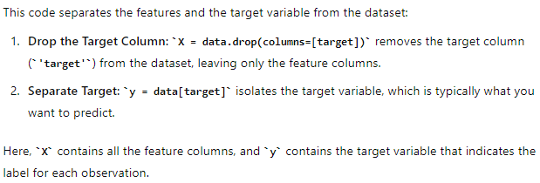

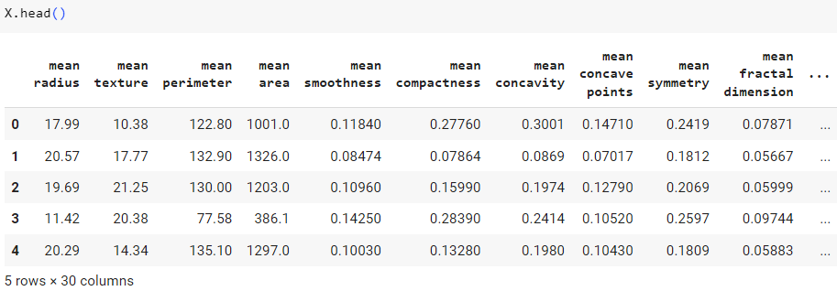
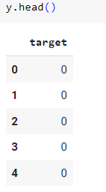

Slide 20
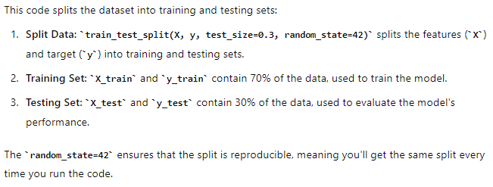
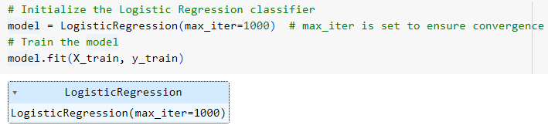
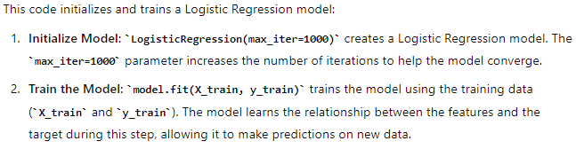

Slide 21
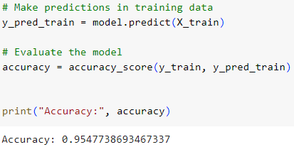
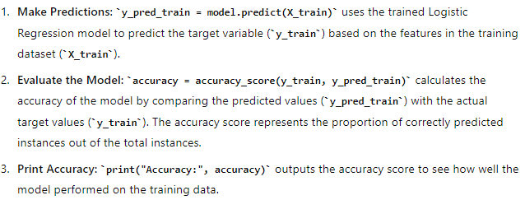
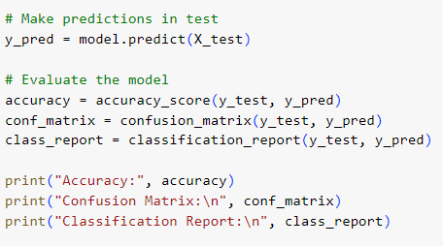
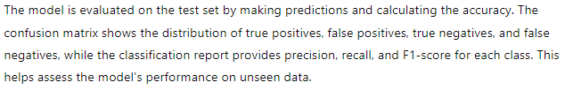

Slide 22
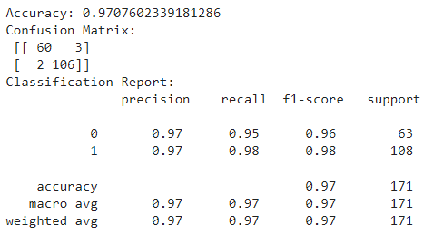
The model achieved an accuracy of 97%, meaning it correctly classified 97% of the test samples. The confusion matrix shows that the model correctly identified 60 benign (0) and 106 malignant (1) cases while misclassifying 3 benign as malignant and 2 malignant as benign. The classification report indicates high precision, recall, and F1-scores for both classes, with the malignant class (1) showing slightly better performance. Overall, the model demonstrates strong performance, particularly in identifying malignant cases.

Slide 23



The classification report's macro and weighted averages are typically used in multi-class classification scenarios (more than two classes). However, these metrics can also be used in binary classification (two classes) to provide a comprehensive performance evaluation. In binary classification, ROC AUC is often preferred for evaluating model performance as it considers the trade-off between the true positive rate (sensitivity) and false positive rate, providing a single score to summarize the model's performance. Therefore, in addition to the classification report, using ROC AUC is beneficial for evaluating the model's effectiveness, especially when dealing with binary classes (0 and 1).

Slide 24
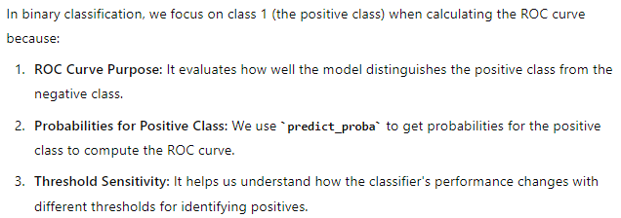
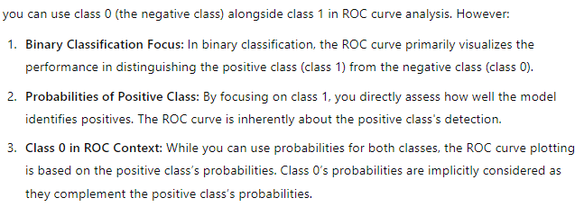

Slide 25
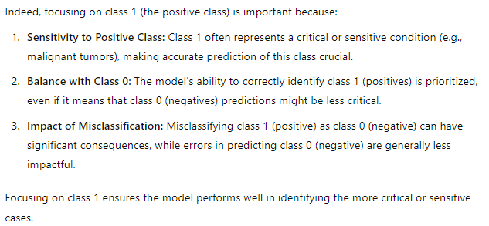

Slide 26

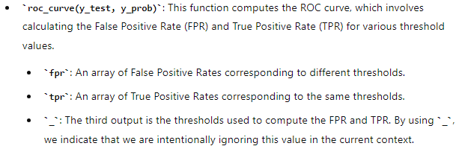

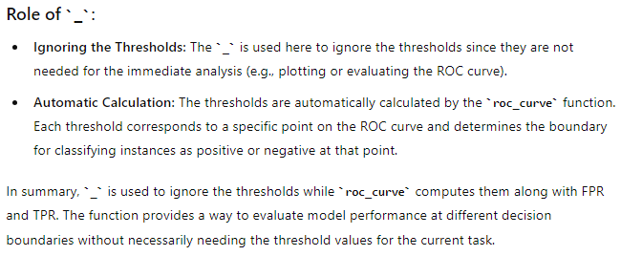

Slide 27
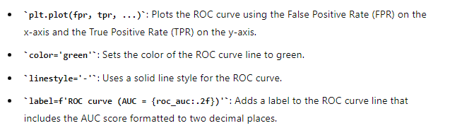
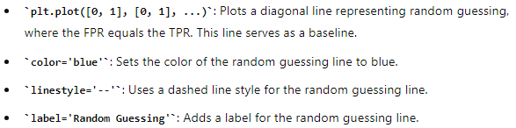
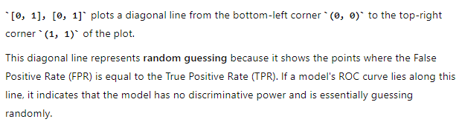

Slide 28



These lines add labels to the x-axis ("False Positive Rate") and y-axis ("True Positive Rate") of the plot, and set the title of the plot as "Receiver Operating Characteristic (ROC) Curve" to clearly describe the axes and the overall purpose of the plot.
Displays the plot.

Slide 29
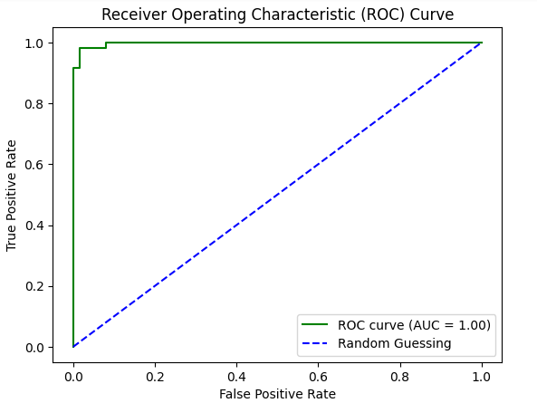



Slide 30


Slide 31
When the ROC AUC is 1, it indicates that the model has perfect discriminatory ability. This means the model can correctly distinguish between the positive and negative classes without making any errors—there are no false positives or false negatives. In other words, the model perfectly separates the classes, making it an ideal classifier.

